Slide 1
Advanced Statistics Lecture 5
Avoiding an inflated alpha

Slide 2
Summary of the first part
We have spent the last lectures talking about the basics of null-hypothesis significance testing (NHST), including considerations of power and what a p-value actually means
We have also discussed an alternative statistical approach that does not involve a null hypothesis (Bayesian Statistics)
In this last part, I want to introduce you to some approaches to diagnose (and perhaps remedy) an inflated alpha rate and questionable research practices in general

Slide 3
Checking p-values
A surprising amount of published articles contains errors in reporting the p-value
For example, the p-value reported does not correspond to the test statistic and degrees of freedom
Nuijten, Hartgerink, van Assen, Epskamp, and Wicherts found that half of psychology papers published between 1985 and 2013 contained at least one incorrect p-value.
They now have a website that can analyse a manuscript automatically and spot problematic p-values

Slide 4
Analysing digits
Benford’s law:
The first digit of any number is more likely to be 1 than to be any other number
The distribution of numbers for the last digit should be uniform
If this is not true for the data of the experiment,something strange is going on
Not necessarily fraud, but maybe some weird rounding issue?
See this Datacolada (Simonsohn, Nelson and Simmon’s blog) post for an example

Slide 5
Reporting requirements
Have authors report the full design that was run, not just the subset that they find interesting
Extreme (and artificial) example: Simmon, Nelson, and Simonsohn’s False Positive Psychology paper
You can get anything significant if you add enough participants, subconditions, etc. without correcting for multiple comparisons
How can you make sure authors tell the truth about their design?

Slide 6
Preregistration
Have authors pre-register their study before actually running it
Either at an independent institution such as the Open Science Foundation (OSF)
Anyone can do it, and even if you can’t get the manuscript published elsewhere, you can put it online there
Or at a journal
Advantage: The journal commits to publishing the manuscript, even if the tests yield null results
Unfortunately, not all journals offer this option yet (although some big cognitive psychology ones have just started)

Slide 7
Open Science
Require authors to share their data (that also enables the digit analysis described above)
Ideally, data sharing becomes the norm voluntarily
but it may also be mandated by journals and research funders (e.g. UK Research and Innovation)
Extra work necessary to prepare the data for publication
Need to safeguard participant privacy
Opens authors up to greater scrutiny
But wouldn’t you want to know if you had made an error?
Authors should be given opportunity to fix (if possible and error wasn’t deliberate)
Of course, scrutiny is different from abuse
Open Science will only work if interactions between authors and commenters are positive and constructive

Slide 8
Meta-analysis
Analyse many studies to get a more consistent picture of the research field
Some studies are clearly outliers
Bayesian meta-analysis gives posterior estimate of effect size – very useful
However: what to do about the file-drawer problem?
What about all the experiments with null effects that were never published?

Slide 9
The p-curve
What does a p-value tell us?
We have talked about Positive Predictive Value and False Discovery Rate
What if we look at all of the published p-values in a field?
p-curve analysis
Try this visualisation by Kristoffer Magnusson to solve the follwing questions:

Slide 10
Question 1
What does the following p-value distribution suggest?

Slide 11
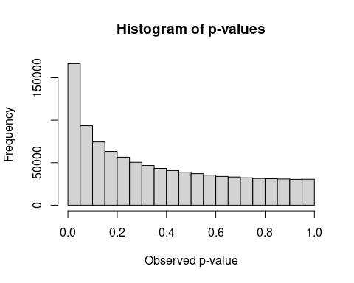

Slide 12
## $breaks ## [1] 0.00 0.05 0.10 0.15 0.20 0.25 0.30 0.35 0.40 0.45 0.50 0.55 0.60 0.65 0.70 ## [16] 0.75 0.80 0.85 0.90 0.95 1.00 ## ## $counts ## [1] 166572 93529 74417 63161 56341 50457 46680 43299 40780 38817 ## [11] 37110 35371 33846 33141 32230 31414 31135 30821 30377 30502 ## ## $density ## [1] 3.33144 1.87058 1.48834 1.26322 1.12682 1.00914 0.93360 0.86598 0.81560 ## [10] 0.77634 0.74220 0.70742 0.67692 0.66282 0.64460 0.62828 0.62270 0.61642 ## [19] 0.60754 0.61004 ## ## $mids ## [1] 0.025 0.075 0.125 0.175 0.225 0.275 0.325 0.375 0.425 0.475 0.525 0.575 ## [13] 0.625 0.675 0.725 0.775 0.825 0.875 0.925 0.975 ## ## $xname ## [1] "p" ## ## $equidist ## [1] TRUE ## ## attr(,"class") ## [1] "histogram"

Slide 13
Question 1
What does the following p-value distribution suggest?
A. The effect the studies are investigating is likely not a real effect.
B. The studies are likely p-hacked.
C. The data are likely falsified.
D. The study was performed with high power (more than .8).

Slide 14
Answer 1
The p-value distribution for this set of studies is skewed to the right (i.e. low p-values are more likely than high p-values), but not strongly.
This is compatible with a real effect, but not very high power
There is no evidence for p-hacking or falsification.
None of the answers below is correct:
A. The effect the studies are investigating is likely not a real effect.
B. The studies are likely p-hacked.
C. The data are likely falsified.
D. The study was performed with high power (more than .8).

Slide 15
Question 2
What if the p-distribution is uniform (i.e., every p-value is equally likely)?

Slide 16
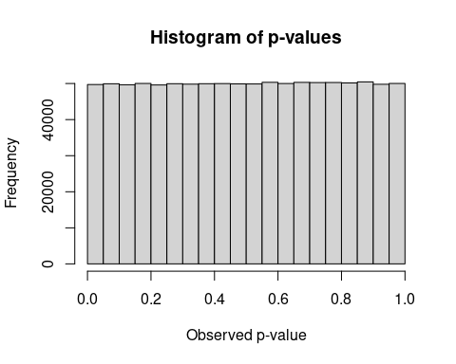

Slide 17
## $breaks ## [1] 0.00 0.05 0.10 0.15 0.20 0.25 0.30 0.35 0.40 0.45 0.50 0.55 0.60 0.65 0.70 ## [16] 0.75 0.80 0.85 0.90 0.95 1.00 ## ## $counts ## [1] 49724 49930 49647 50021 49600 49947 49823 49948 49975 49897 49879 50332 ## [13] 50006 50318 50262 50285 50157 50446 49788 50015 ## ## $density ## [1] 0.99448 0.99860 0.99294 1.00042 0.99200 0.99894 0.99646 0.99896 0.99950 ## [10] 0.99794 0.99758 1.00664 1.00012 1.00636 1.00524 1.00570 1.00314 1.00892 ## [19] 0.99576 1.00030 ## ## $mids ## [1] 0.025 0.075 0.125 0.175 0.225 0.275 0.325 0.375 0.425 0.475 0.525 0.575 ## [13] 0.625 0.675 0.725 0.775 0.825 0.875 0.925 0.975 ## ## $xname ## [1] "p" ## ## $equidist ## [1] TRUE ## ## attr(,"class") ## [1] "histogram"

Slide 18
Question 2
What if the p-distribution is uniform?
A. The effect the studies are investigating is likely not a real effect.
B. The studies are likely p-hacked.
C. The data are likely falsified.
D. The study was performed with high power (more than .8).

Slide 19
Answer 2
What if the p-distribution is uniform?
A. The effect the studies are investigating is likely not a real effect.
B. The studies are likely p-hacked.
C. The data are likely falsified.
D. The study was performed with high power (more than .8).

Slide 20
Question 3
What does the following p-value distribution suggest?

Slide 21
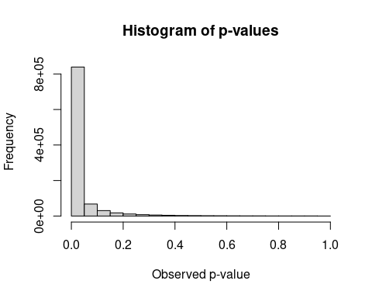

Slide 22
Question 3
What if the p-distribution is strongly skewed to the right?
A. The effect the studies are investigating is likely not a real effect.
B. The studies are likely p-hacked.
C. The data are likely falsified.
D. The study was performed with high power (more than .8).

Slide 23
Answer 3
What if the p-distribution is strongly skewed to the right?
A. The effect the studies are investigating is likely not a real effect.
B. The studies are likely p-hacked.
C. The data are likely falsified.
D. The study was performed with high power (more than .8).

Slide 24
Question 4
What if the curve looks like this?

Slide 25
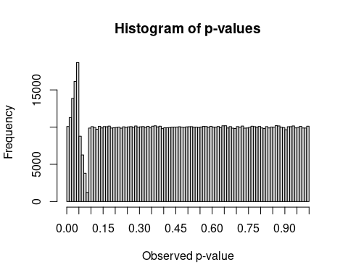

Slide 26
Question 4
What if the p-distribution has a “bump” below .05 and is otherwise flat?
A. The effect the studies are investigating is likely not a real effect.
B. The studies are likely p-hacked.
C. The data are likely falsified.
D. The study was performed with high power (more than .8).

Slide 27
Answer 4
What if the p-distribution has a “bump” below .05 and is otherwise flat?
A. The effect the studies are investigating is likely not a real effect.
B. The studies are likely p-hacked.
C. The data are likely falsified.
D. The study was performed with high power (more than .8).

Slide 28
Using the p-curve as a diagnostic tool
You need a large(r) number of significance tests (e.g. from all the studies on a particular phenomenon such as Power Posing)
If there is no effect (or low power), the p-curve will be approximately flat.
If there is a real effect (and at least medium power), the p-curve will be right-skewed, with low p-values more likely than high p-values

Slide 29
What if a research field systematically neglects to publish non-significant results?
To the left of .05, the p-distribution is the same as it should be (all results with p<.05 are published)
To the right of .05, p-values get a lot less frequent as they end up in the file drawer
There will be a bump in the distribution just below .05

Slide 30
Try it in Felix Schönbrodt’s p-hacker simulation
p-hacker: Train your p-hacking skills!
You can run lots of studies without correcting for multiple comparisons
You can also add predictor variables that weren’t in your original hypothesis
Eliminate outliers, test more participants, etc. while always checking the p-value after every change
You can then send the p-values from your simulations to the p-checker app to draw a p-curve
The p-checker app also has several other useful tests that are explained on the website

Slide 31
Lowering the alpha
This is a fairly extreme proposal, but it has had a lot of support in recent years.
Basic idea: since most studies are going to have an inflated false positive rate anyway, let’s keep it acceptable as a whole by lowering the alpha level required for calling a result “significant”
Is this a good idea? Lots of researchers think so. Lots of others don’t.
Your task for Assignment 2: Come to your own conclusion and describe the debate and your standpoint in your own words.

